Slide 1




||Jai Shri Gurudev||
Sri Adichunchanagiri Shikshana Trust
SJB Institute of Technology
An Autonomous Institute under VTU
Department of Artificial Intelligence and Machine Learning
(Approved by AICTE-New Delhi , Recognized by UGC, Accredited by NAAC with ‘A+’ Grade, Accredited by National Board of Accreditation)
Presentation on Mini-Project
Title: AI CODE EXPLANATION TOOL
Presented by:
Benaka R N-1JB22AI008
Aasim Pasha-1JB22AI002
Kanishka N-1JB22AI023
Aditya A M-1JB22AI003
Department HOD:
Dr. Gopalakrishna M.T
SJB Institute of Technology
Under the guidance of
Dr. Nagananda M S
Professor Dept of AI&ML , SJBIT

Slide 2
Agenda
Introduction to AI in Python
The need for code explainer
Key features
GROQ API overview
Hardware Resources
Software Resources
Integration along with coding
Future of AI in development

Slide 3


Introduction to AI in Python
AI plays a crucial role in enhancing Python programming
AI-powered code explanation tool can improve coding efficiency and understanding

Slide 4


The need for code explanation
Python code becomes challenging
Developers often require clarity
AI-powered tool can provide instant explanations

Slide 5

How AI enhances learning
AI algorithms can analyze code and generate explanations
This approach allows developers to grasp concepts quickly
It empowers both amateurs and experienced developers

Slide 6

Key features of the tool
Real-time analysis
contextual explanations
Helps developers improve their coding practices

Slide 7

GROQ API Overview
Flexibility: Ideal for working with structured, relational, and
nested content
Simplicity: Intuitive JSON-based syntax for quick development
Performance: Optimized for querying large datasets in headless
CMS environments

Slide 8
Software Requirements
HTML:-For structuring the web interface
CSS :- Styling and encasing user experience
FLASK:-Web framework python for backend
Python:- Programming language powers backend logic
LLaM3:-Designed for advanced NLP with improved capabilities and scalability

Slide 9
Hardware Resource used
Processor : Multi-core CPU for efficient processor
Memory : Minimum 8GB, I6 GB recommended
Storage : SSD, at least 256 GB capacity
Graphics card : Optional GPU for faster computation
Network : Reliable internet for online resources
Display : 1080p monitor for clear visuals

Slide 10


Integration along with coding
Visual Studio Code
Google Colab
Jupyter

Slide 11

Real-World Applications
Quickly understand complex code.
Automatically generate explanations for code.
Identify and explain errors in code.
Improve communication among team members.

Slide 12

BENEFITS
Increased efficiency
Reduced debugging time
Enhanced collaboration
Time-consuming

Slide 13

Future of AI in Development
Better understanding and explaining complex code
Easier for everyone to learn and work with code

Slide 14
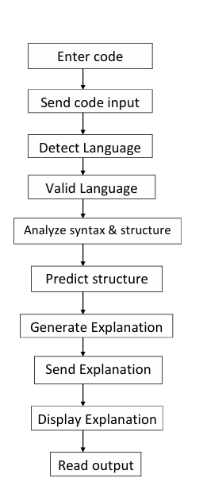
Sequence transition diagram
.

Slide 15
Business applications
1.Chatbots and Virtual Assistants - Algorithms, like Natural Language Processing (NLP), can raise queries
Ex: AI assistants like Google Assistant, Siri
2. AI-Powered Code Learning Platform - Build a platform where users can upload code snippets & AI explains every line, errors, and improves
Ex:Programming students, bootcamp learners
3.AI-Enhanced Code Migration Tool - Help organizations migrate legacy code to modern frameworks, explaining every change
Ex:Enterprises, tech companies

Slide 16
Conclusion and Takeaways
Enhances Python development
Helps in understanding code
Fosters a culture of continuous learning and improvement
Significant advancements in coding practices

Slide 17
THANK YOU

